Slide 1
Software Engineering for Machine Learning
Dr. Shreyas Rao
Associate Professor, Dept. of CSIS, BITS-Pilani

Slide 2
AIMLCZG546
Lecture No. 6

Slide 3
Agenda
Architectural Patterns for ML Systems
Event-driven Architecture
Design Patterns for ML Systems
Model Registry Pattern
Batch vs Real-Time Serving Pattern

Slide 4
Event Driven Architecture

Slide 5
Event Driven Architecture
Context
You are designing a complex software system that needs to handle various asynchronous events, messages, and notifications. These events could be triggered by user actions, external systems, or internal processes. Your goal is to create a system that can efficiently process and respond to these events in a scalable and decoupled manner.
Problem:
Asynchronous Communication: Your system needs to support asynchronous communication to handle events that occur at different times and are not tightly coupled to each other.
Decoupling: You want to ensure that different parts of the system can communicate without being tightly coupled, allowing for independent development, scalability, and maintenance.
Scalability: The system must be able to scale horizontally to handle an increasing volume of events without adding complexity or bottlenecks.
Reliability: You need to ensure that events are reliably delivered and processed, even if components or services go offline temporarily.

Slide 6
Event Driven Architecture
Solution
A. Publish-Subscribe Model:
Publishers: Components or services that generate events publish them to an event bus or message broker.
Subscribers: Components or services interested in specific types of events subscribe to the event bus. They receive notifications when relevant events occur.
B. Message Brokers: Message brokers, such as Apache Kafka, RabbitMQ, or cloud-based services like Amazon SQS or Azure Service Bus, play a crucial role in event-driven architectures. They ensure reliable event delivery, message queuing, and event persistence.

Slide 7
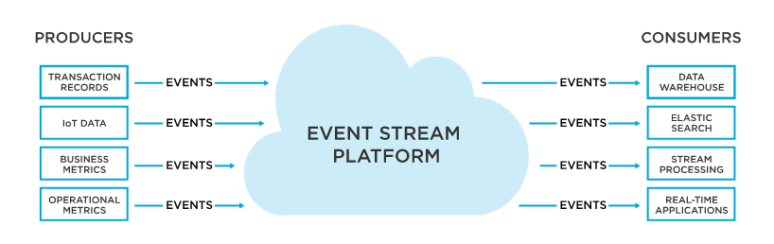
Event Driven Architecture
Producers or Publishers
Consumers or
Subscribers

Slide 8
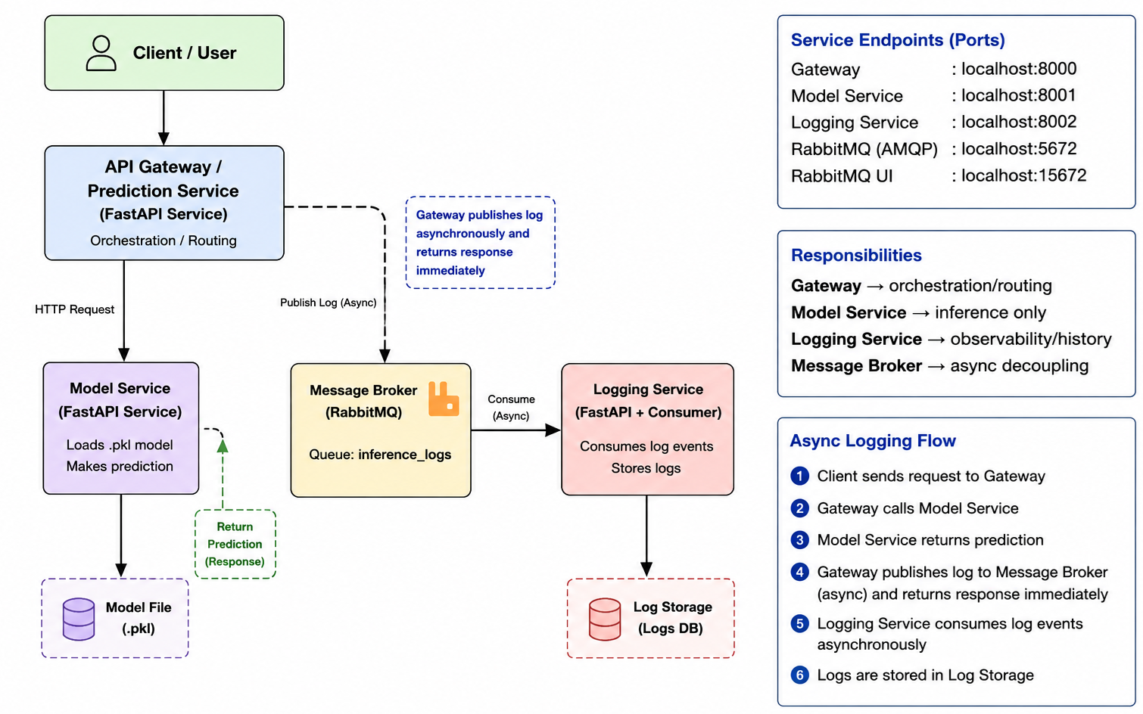
Implementation -- Demo
[Modified version of Microservices]

Slide 9
Design Patterns for ML Systems

Slide 10
Design Patterns for ML Systems
Design patterns for Machine Learning (ML) systems are established best practices that solve recurring challenges in data preparation, model training, and production serving.

Slide 11
Model Registry Pattern

Slide 12
Registry Pattern
Software Engineering
“A creational design pattern acting as a central hub to dynamically register, locate, and retrieve class instances or services”
Machine Learning
“A centralized repository that tracks, versions, manages, and governs machine learning models throughout their lifecycle”

Slide 13
Common Terms
Repository (The Storage)
A repository (or "repo") is the central digital storage location for your project’s files and their entire history.
Local Repository: Stored on your own machine for individual work.
Remote Repository: Hosted on a server (like GitHub, GitLab, or Bitbucket) so teams can collaborate and share changes.
ML Repository / Model Repository: Stores ML artifacts such as models, datasets, experiment logs, and metadata using tools like MLflow, DVC, or Weights & Biases.
Function: It doesn't just store current files; it keeps every previous version as a "snapshot"

Slide 14
Evolution of Version Control
Definition: Version control is a system that records changes to a file or set of files over time so that you can recall specific versions later
The history of version control tools can be divided into three generations
Generation | Networking | Operations | Example Tools (VCS)
First Generation (SD) | None | One file at a time | RCS, SCCS
Second Generation (SD) | Centralized | Multi-file | CVS, Subversion
Third Generation (SD) | Distributed | Changesets | GIT
Third Generation (ML) | Distributed + Artifact Tracking | Models, Data, Experiments | MLflow, DVC, Weights & Biases
*Here, SD refers to Software Development and ML to Machine Learning

Slide 15
About GIT
Git is a distributed version control system (VCS) that is widely used for tracking changes in source code during software development.
It allows multiple developers to work on a project simultaneously and keeps track of all modifications made to the codebase over time.
Git was created by Linus Torvalds, the creator of the Linux operating system, in 2005.

Slide 16
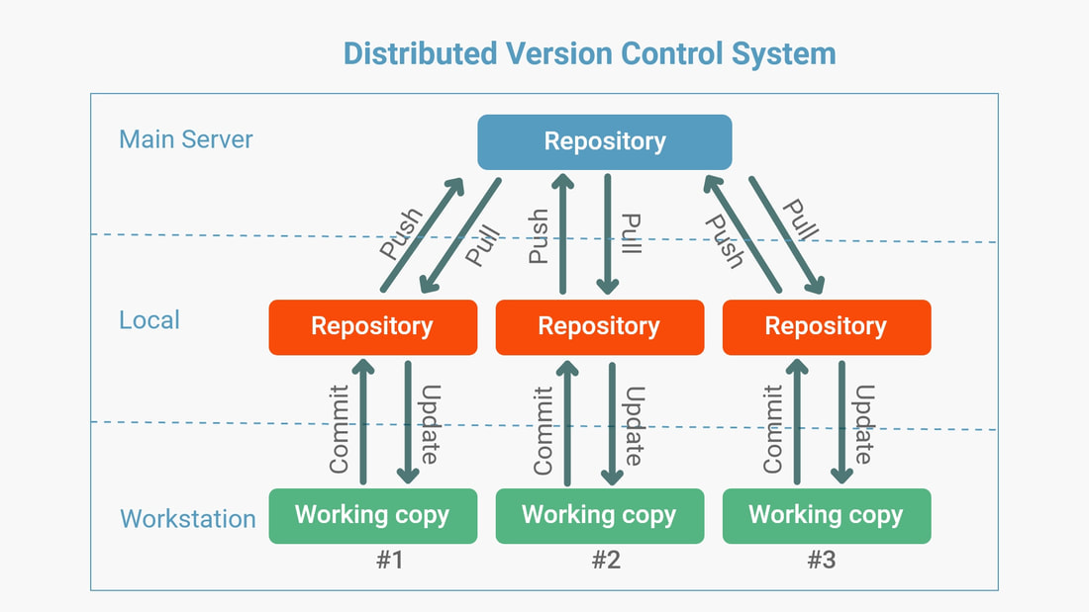
Distributed Version Control System (GIT)

Slide 17
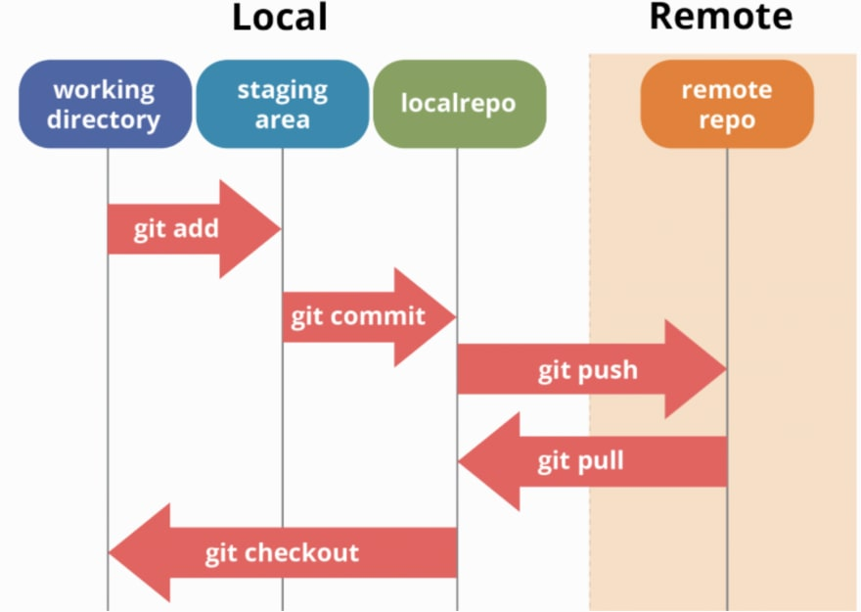
Basic GIT Workflow

Slide 18
Model Registry Pattern (MLOps)
Redhat definition
In data science, the model registry serves as the definitive "source of truth" bridging the gap between model experimentation and production serving. It tracks the entire model lineage from development to deployment

Slide 19
Difference between GIT & ML Registry
Git versions source code
ML registry versions ML artifacts
Git stores: source files, documentation., configuration
ML Registry stores
trained models
model weights
datasets or references
hyperparameters
metrics
experiment logs
lineage information

Slide 20
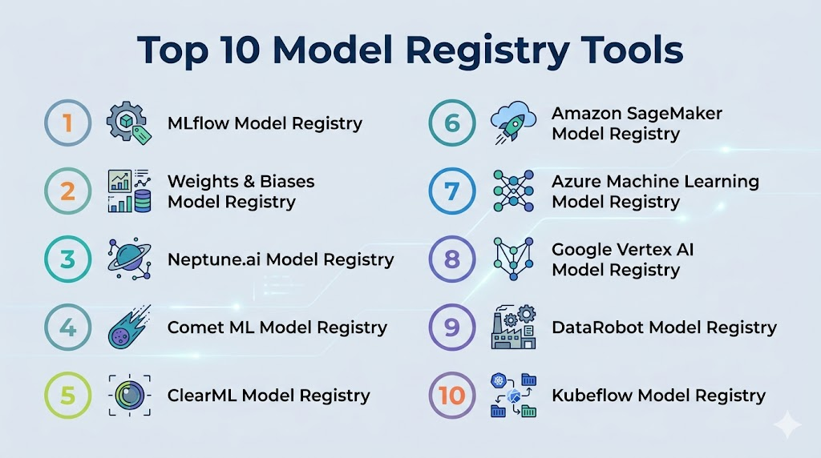
Model Registry Tools

Slide 21
MLFlow Registry
The MLflow Model Registry is a centralized model store, set of APIs and a UI designed to collaboratively manage the full lifecycle of a machine learning model.
It provides lineage (i.e., which MLflow experiment and run produced the model), versioning, aliasing, metadata tagging and annotation support to ensure that you have the full spectrum of information at every stage from development to production deployment.

Slide 22
MLFlow Registry - Features
Version Control: Tracks and manages multiple model versions, enabling comparison, rollback, and parallel deployment workflows.
Model Lineage and Traceability: Links each model version to its training run, data, and parameters for full reproducibility and traceability.
Production-Ready Workflows: Supports controlled promotion and deployment of models using aliases, tags, and environment-based workflows.
Governance and Compliance: Provides metadata, access control, and auditability to support enterprise governance and compliance needs.

Slide 23

Demo of MLFlow
https://www.youtube.com/watch?v=HIb0Y_XaR5s&list=PLvvQ7qimTOknFNB1WloA0s-aRXkA9b6Ib&index=6

Slide 24
Batch vs Real-time Serving Pattern
[Deployment pattern]

Slide 25
Batch vs Real-time Serving
Batch and real-time serving are two fundamental design patterns for handling and delivering data in software engineering.
They trade off between data freshness and operational complexity.

Slide 26
Batch Prediction: Processing Data in Bulk
Batch prediction, also known as offline prediction, is a process where the model computes predictions for a large set of observations all at once
Ex: Imagine you want to send a daily promotional email to customers who are most likely to purchase a specific product. There is no need to identify these customers in real-time. Instead, a process can run every night, analyze the day's customer activity, generate a list of target customers, and save that list for the marketing team to use the next morning.
https://apxml.com/courses/introduction-to-mlops/chapter-5-model-deployment-and-serving/deployment-patterns-online-batch

Slide 27
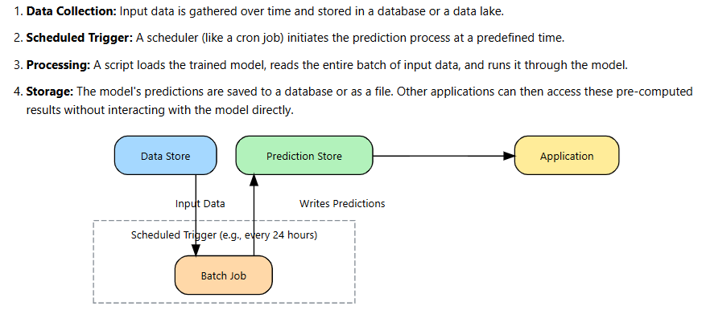
Batch prediction
https://apxml.com/courses/introduction-to-mlops/chapter-5-model-deployment-and-serving/deployment-patterns-online-batch

Slide 28
When to use Batch prediction
Batch prediction is suitable when immediate predictions are not a business requirement.
Common use cases include
Customer Segmentation: Grouping customers into segments based on their purchasing behavior over the last week.
Product Recommendations in Emails: Generating personalized product recommendations to include in a daily newsletter.
Risk Reporting: Calculating credit risk scores for all loan applicants at the end of the business day.
https://apxml.com/courses/introduction-to-mlops/chapter-5-model-deployment-and-serving/deployment-patterns-online-batch

Slide 29
Online Prediction: Serving predictions on demand
Online prediction, also called real-time or on-demand inference, is designed to provide predictions immediately. In this pattern, the model is deployed as a persistent service, often as a web API, that is always running and waiting for requests.
Ex: A website must decide whether to approve a credit card transaction. The decision must be made in milliseconds while the customer is waiting at the checkout. An application sends the transaction details to the model's API, and the model must return a "approve" or "deny" prediction almost instantly.
https://apxml.com/courses/introduction-to-mlops/chapter-5-model-deployment-and-serving/deployment-patterns-online-batch

Slide 30
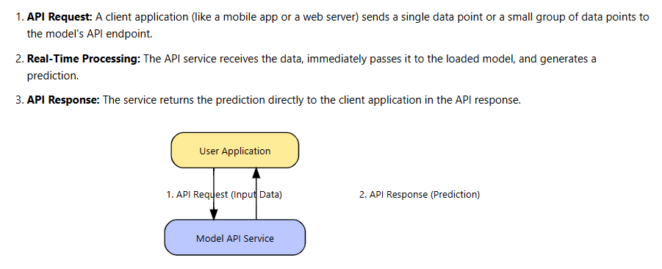
Realtime prediction
https://apxml.com/courses/introduction-to-mlops/chapter-5-model-deployment-and-serving/deployment-patterns-online-batch

Slide 31
When to use Realtime prediction
Online prediction is necessary whenever an application requires an immediate response to function correctly.
Common examples include
Fraud Detection: Analyzing a transaction in real-time to block it before it is completed.
Dynamic Pricing: Adjusting the price of a ride-share service based on current supply and demand.
Spam Filtering: Deciding whether an incoming email is spam before it lands in the user's inbox.
https://apxml.com/courses/introduction-to-mlops/chapter-5-model-deployment-and-serving/deployment-patterns-online-batch

Slide 32
Quick Recap…Batch vs Realtime

Slide 33


